Slide 1




Decoding the Conversations :
ANALYSIS-BASED
WHATSAPP CHAT ANALYSIS
>> Presented by:
Umar Javed
Danish Ali
Asifa hamid khan

Slide 2



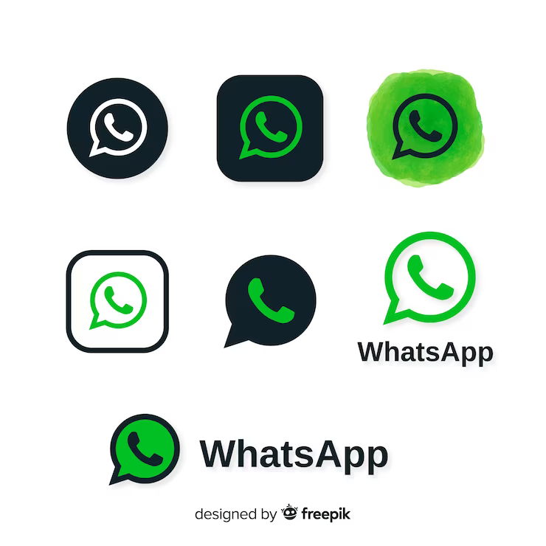
CONTENT
01
02
03
overview
working
application
04
05
06
07
adavantages
disadvantages
conclusion
result

Slide 3






PROJECT OVERVIEW
PURPOSE
USER-FRIENDLY INTERFACE
Chat Analyzer is a powerful tool designed to analyze and extract insights from WhatsApp conversations, providing valuable data for personal and professional use.
The platform offers an intuitive and user-friendly interface, making it accessible for individuals and organizations seeking to gain meaningful insights from their WhatsApp chats.

Slide 4



WORKING
Data pre-processing is the initial part of the project, it is to understand the implementation and usage of various
python inbuilt modules.
data
Visualization
01
Intially open WhatsApp chat analyzer web page and select Date format (24 hours).
02
Upload the exported chat file.
Analyzing of data is done by trained model.
data
analysis
03
Preprocessing of data is done by trained model. Then select overall or single person analysis.
data
loading & preprocessing
04
Trained model shows analysis it includes top statistics, word cloud, activity map, monthly timeline, daily timeline, emoji analysis
Data exporting
(whatsapp chat file)

Slide 5


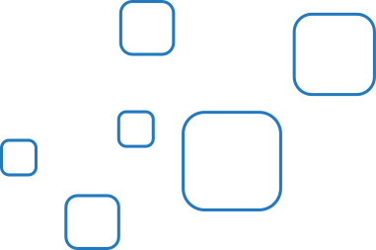
APPLICATION
Personal Reflection : Chat Analyzer enables individuals to reflect on their personal conversations, gaining insights into their communication patterns and emotional expressions.
Professional Insights : In a professional context, Chat Analyzer can be used to analyze customer interactions, team communications, and market trends, informing strategic decision-making.
Educational Use : Educators and researchers can utilize Chat Analyzer to analyze student discussions, research group interactions, and language patterns within educational settings.

Slide 6

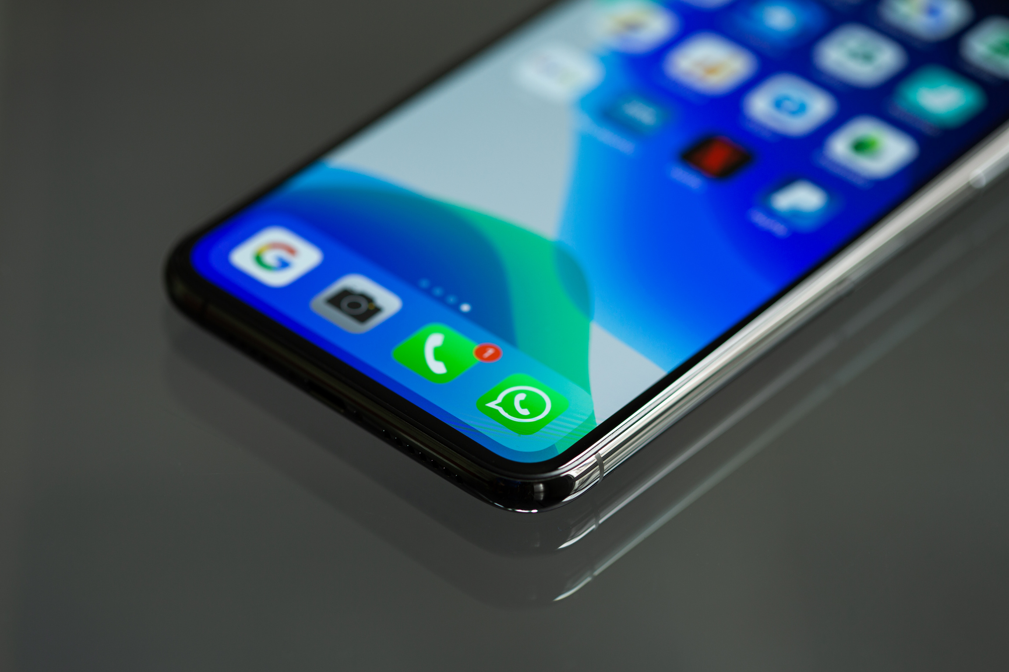

ADVANTAGES
Insight into User Behavior
Customer Engagement
Market Research
Decision-Making Support
Personal Growth and Development
Business Optimization
Educational Enrichment
DISADVANTAGES
Privacy Concerns
Data Accuracy Challenges
Technical Challenge

Slide 7






CONCLUSION
We can conclude that the capabilities of the WhatsApp application and the power of the python programming language in implementing our data analysis intended, cannot be overemphasized.
The system was done with python, and the python libraries that were implemented includes, Streamlit, Emoji, NumPy, Pandas, Re, Matplotlib, URL extract, collection and Seaborn.
Finally conclude that we intended were obtained. The future of our project is it is mainly useful for organisers.
Then will get to know who is more and least active in the
group. Depending on that they can take decisions.

Slide 8


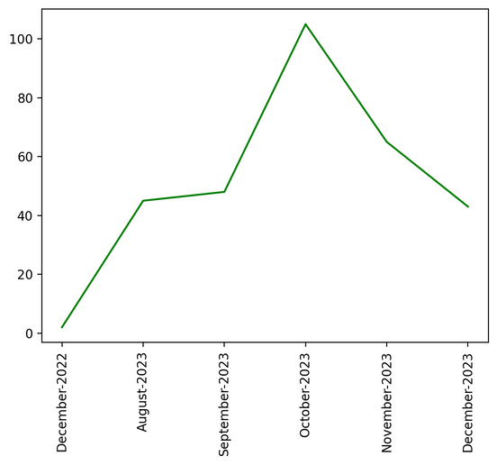
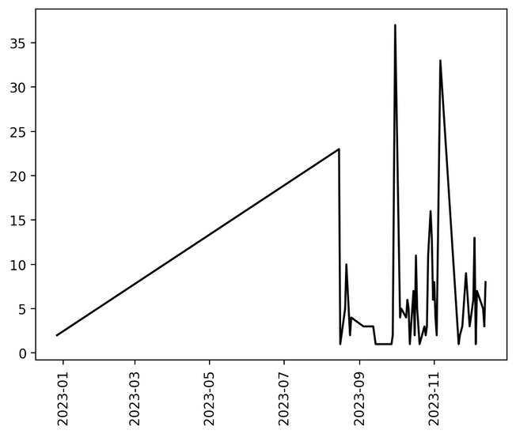

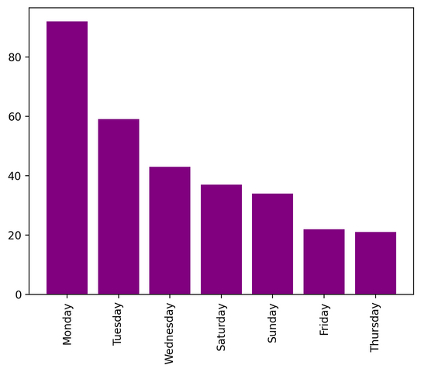
RESULT
>Top Statistics
total
messages
total
words
media
shared
links
shared
308
1566
116
4

Slide 9
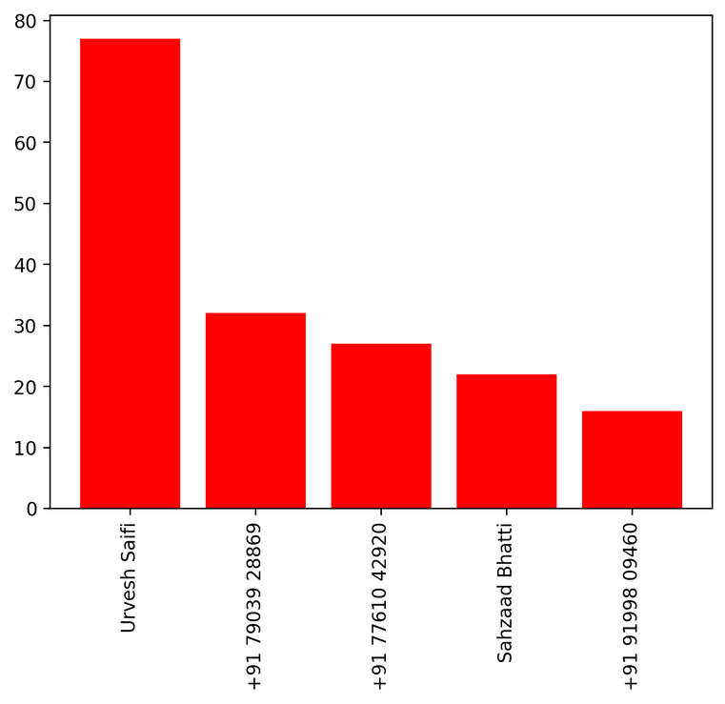
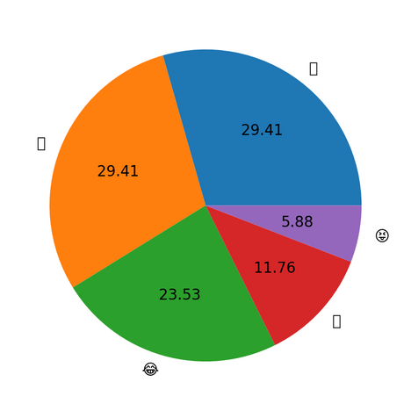
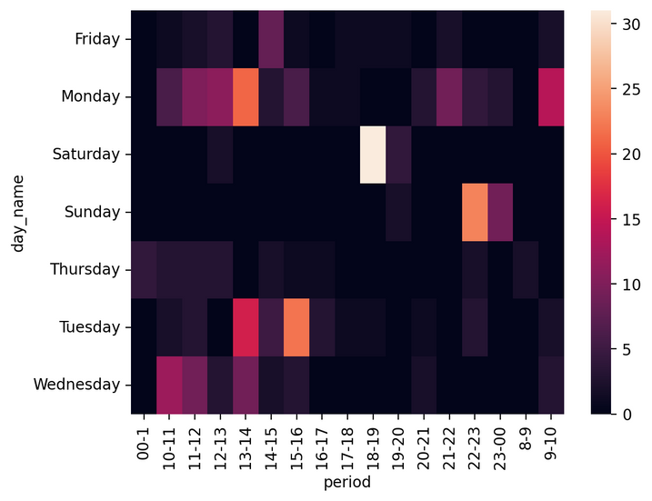
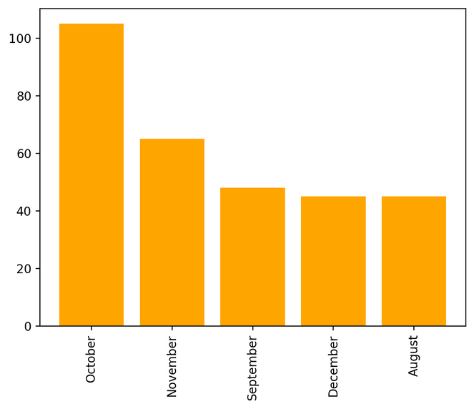

RESULT

Slide 10




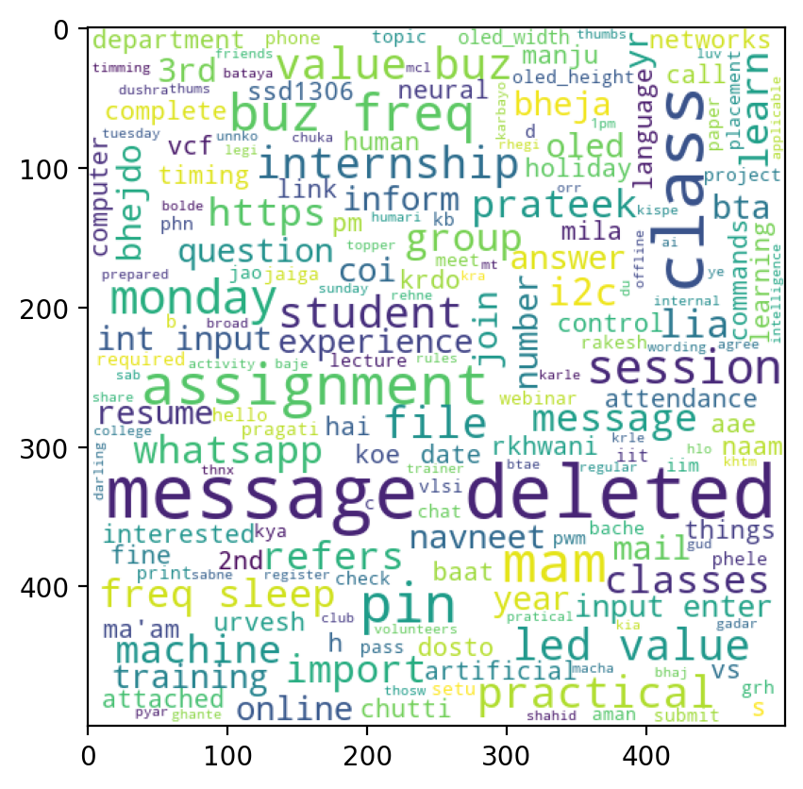



OUR TEAM
DANISH
ALI
TECHNICAL LEAD
umar
javed
LEADER
ASIFA HAMID
KHAN
FACILITATOR

Slide 11




Connect with us.
+91 70811 67504 ( Umar Javed)
umarjavedaiml21@gmail.com
+91 72503 19020 ( Danish Ali)
danishali@gmail.com

